Slide 1
CSS342 Data Structures, Algorithms, and Discrete Mathematics (I)

Slide 2
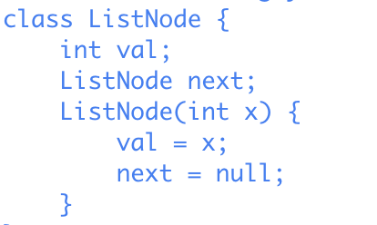
Quiz
Problem 1: What is the benefit of using Linked List to implement a Stack comparing to using Java primitive array such as int[]?
Problem 2: Given the ListNode definition on the right, complete the following function that returns the reference to the last node of the SingleLinkedList. It return null if list is empty.
public ListNode goToLastNode(ListNode head) {
// write your code
}
No dummy node. The head could be null

Slide 3
Quiz
What is the benefit of using Linked List to implement a Stack comparing to using Java primitive array such as int[]?
What is the benefit of Linked List comparing to Java primitive array such as int[]?

Slide 4
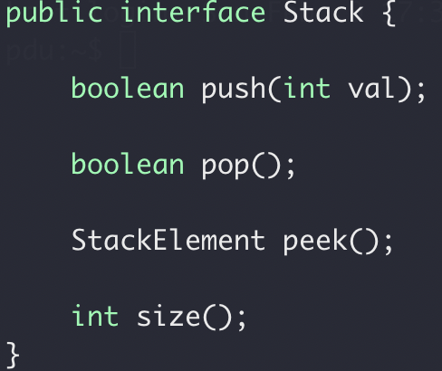
Exercise
How to implement a Stack using a Java primitive Array?
0
1
2
3
4
5
How to implement a Stack using a Linked List?
h
1
3
5
7
9
10

Slide 5
Exercise
Stack
Array
LinkedList

Slide 6
Quiz
Problem 2: Given the ListNode definition on the right, complete the following function that returns the reference to the last node of the SingleLinkedList. It return null if list is empty.
public ListNode goToLastNode(ListNode head) {
// write your code
}
No dummy node. The head could be null

Slide 7
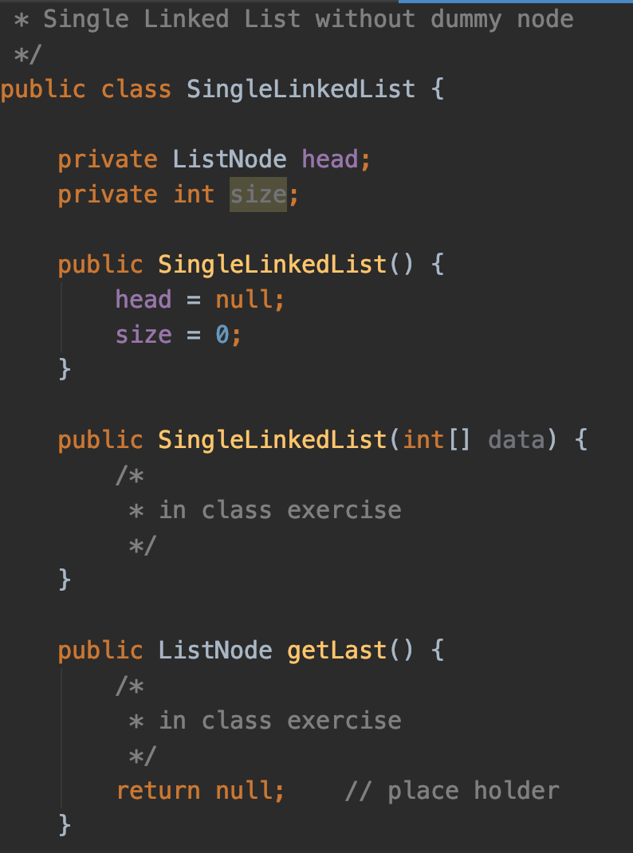
In-class exercise
Implement SingleLinkedList(int[] data)
Implement getLast(int[] data)

Slide 8
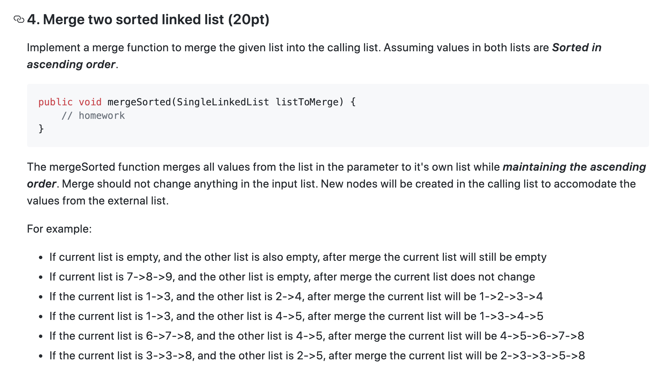
In-class Exercise/Demo

Slide 9
Merge sorted single linked list
head
d
1
3
null
Compare p0.next.val and p1.val
p0
head
d
2
4
null
p1

Slide 10
Merge sorted single linked list
1
2
head
d
3
null
Compare p0.next.val and p1.val
p0
head
d
2
4
null
p1

Slide 11
Merge sorted single linked list
In place
head
d
1
2
3
4
null
Compare p0.next.val and p1.val
p0
head
d
2
4
null
p1

Slide 12
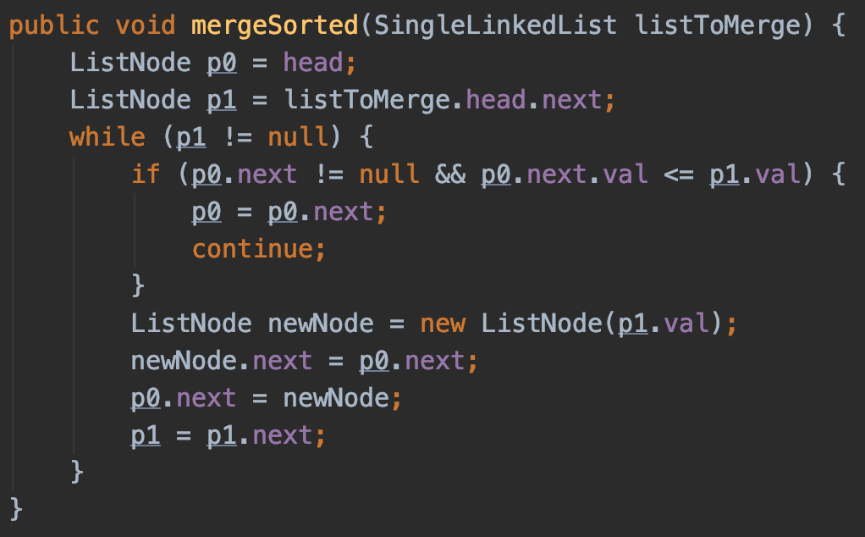
Merge sorted single linked list

Slide 13
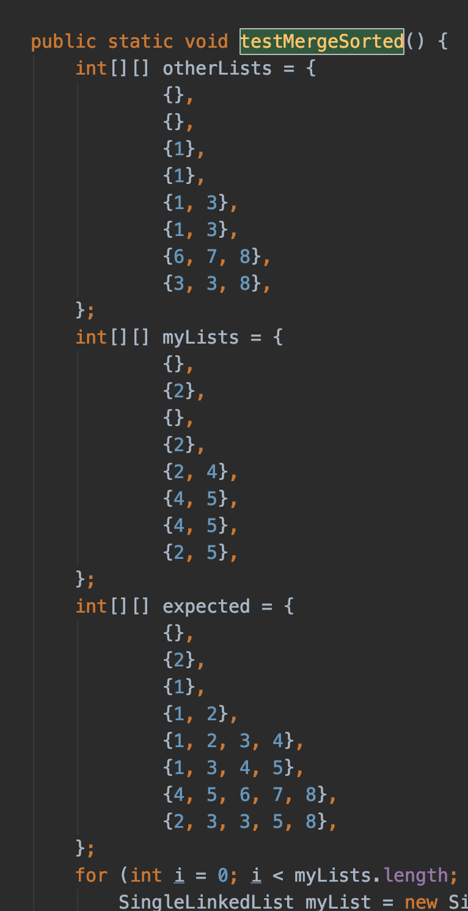
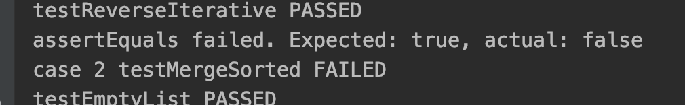
Merge sorted single linked list
d
1
head
d
null
head
null
head
d
1
null

Slide 14
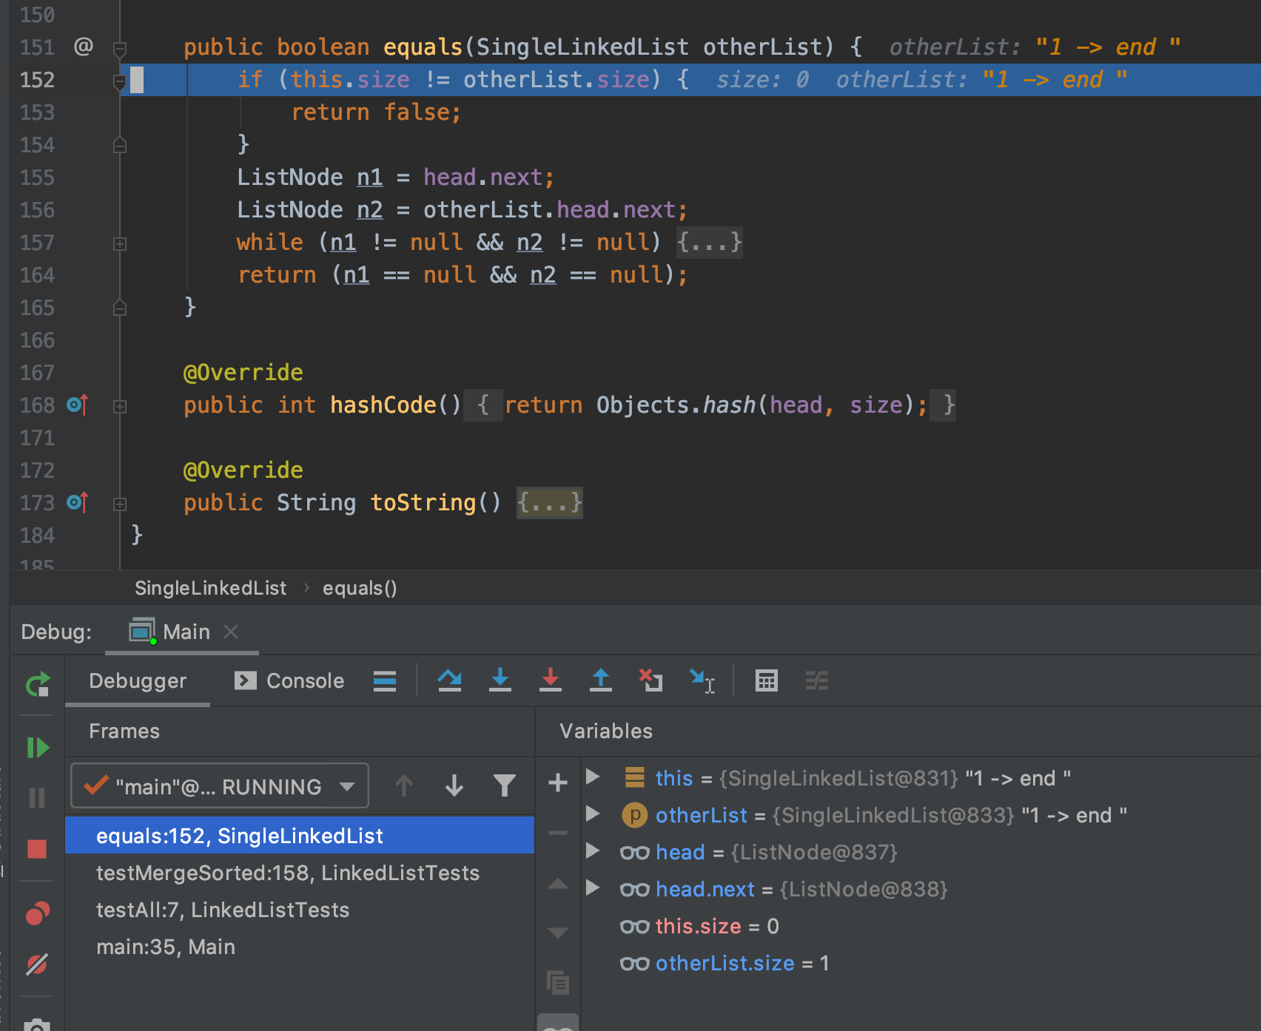
Breakpoint

Slide 15
A Search Problem
Target: 14
1
3
5
7
9
10
12
12
14
14
18
0
1
2
3
4
5
6
7
8
9
O(log₂N)
log₂10 = 3.322 comparions
worst case scenario

Slide 16
A Search Problem
Target: 14
18
12
1
7
5
10
3
12
9
14
14
0
1
2
3
4
5
6
7
8
9
O(N)
N = 10 comparisons
Worst case scenario

Slide 17
A Search Problem
Can we do better than O(N)?
Option 1: Change the way we solve problems
Option 2: Improve problem condition

Slide 18
A Search Problem
Can we do better than O(N)?
Option 1: Change Algorithm
Option 2: Change Data Structure

Slide 19
A Search Problem
Option 1: Change Algorithm
18
12
1
7
5
10
3
12
9
14
14
0
1
2
3
4
5
6
7
8
9
Sort
O(N²) to O(N log₂N)
1
3
5
7
9
10
12
12
14
14
18
0
1
2
3
4
5
6
7
8
9

Slide 20
A Search Problem
First Sort
Then Search
O(N log₂N)
10 * log₂10 = 33.22 comparisons
O(log₂N)
log₂10 = 3.32 comparisons
Linear search is O(N)
10 comparisons

Slide 21
A Search Problem
And what if we need to add new numbers once in a while
First Sort
Then Search
O(N log₂N)
10 * log₂10 = 33.22 comparisons
O(log₂N)
log₂10 = 3.32 comparisons
Wait! Linear search is O(N)
10 comparisons

Slide 22
A Search Problem
First Sort
Then Search
O(N log₂N)
10 * log₂10 = 33.22 comparisons
O(log₂N)
log₂10 = 3.32 comparisons
Wait! Linear search is O(N)
10 comparisons

Slide 23
A Search Problem
Can we do better than O(N)?
Option 1: Change Algorithm
Option 1: Change Algorithm
Option 2: Change Data Structure

Slide 24
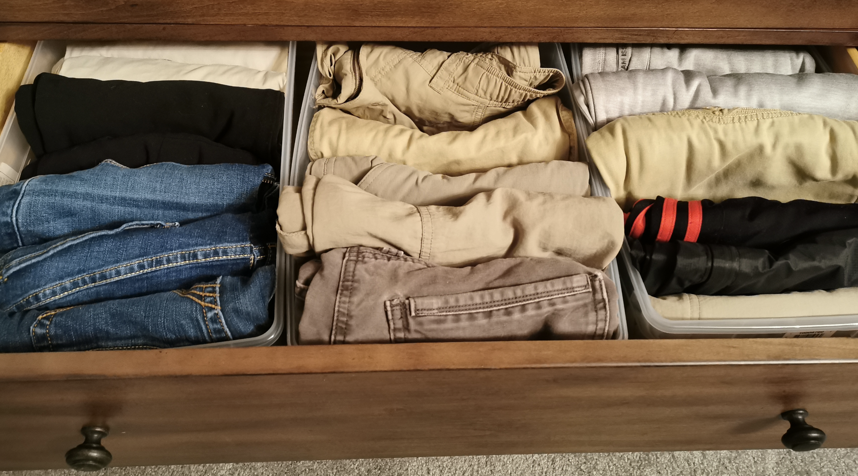

A Search Problem
What if the data is automatically sorted when it’s provided/inserted ?

Slide 25
A search problem
data is automatically sorted when it’s inserted
18
12
1
7
5
10
3
12
9
14
1
3
5
7
9
10
12
12
14
18

Slide 26
A search problem
data is automatically sorted when it’s inserted
13
1
1
3
3
5
5
7
7
9
9
10
10
12
12
12
12
14
13
18
14
18
When there’s new data, insert it into the sorted place
When search, use binary search
O(log₂N) with shuffling
O(log₂N) with shuffling
O(log₂N)

Slide 27
A search problem
Array → Shuffling
What about other data structure instead?
1
3
5
7
9
10
12
12
14
18
0
1
2
3
4
5
6
7
8
9
1
1
3
3
5
5
9
9
10
10
12
12
18
12
18
7
12
7
14
14

Slide 28
A search problem
Array → Shuffling
What about other data structure instead?
1
3
3
5
7
9
9
10
12
12
12
14
18
0
1
2
3
4
5
6
7
8
9
3
9
12
9
3
12
1
5
10
14
7
12
18

Slide 29
A search problem
13
9
9
13
3
12
13
1
5
10
14
13
7
12
18
13
13
When there’s data, insert it into the sorted place
When search, binary search traverse the tree
O(log₂N) with shuffling
O(log₂N)

Slide 30
A search problem
Target: 14
?
9
9
?
3
12
1
5
10
14
?
14
7
12
18
Binary Search
Tree

Slide 31
Binary Search Tree
A Binary Search Tree (BST) is a tree in which all the nodes follow the below-mentioned properties:
The left sub-tree of a node has a key less than or equal to its parent node's key.
The right sub-tree of a node has a key greater than to its parent node's key.

Slide 32
Exercise
Is this a binary search tree?
3
1
5
7

Slide 33
Exercise
Is this a binary search tree?
8
3
10
14
1
6
4
7

Slide 34
Exercise
Is this a binary search tree?
8
3
10
14
5
6
4
7

Slide 35
Exercise
Is this a binary search tree?
8
3
10
2
14
1
6
4
7

Slide 36
Exercise
Is this a binary search tree?
2
3
5
7
9

Slide 37
A Search problem
Sorted array → binary search
Random array
Sort first, and then binary search
Keep data always sorted when creating the data
Array → data shuffling
Linked list?
Binary tree

Slide 38
Kinds of Trees
Binary Search Tree
Fast search
Fast insert
Binary Tree

Slide 39
Binary Tree Definition
9
9
Parent
12
3
12
1
5
Child
5
10
10
14
Parent
7
12
18
7
Child

Slide 40
Binary Tree Definition
Root
9
9
9
3
12
1
5
1
5
10
14
7
12
12
18
7
18
Leaf : node without any children node

Slide 41
Binary Tree Definition
3
1
5
7
Height of a tree:
Number of nodes
on the longest path
from root to leaf
5
Height = 4
3
3
3
9
1
5
1
1
5
7
Height = 3
Height = 1
Height = 2
Height = 2

Slide 42
Tree ADT
3
Implementation
Data storage:
Array
List
1
5
2
7
8
3
1
5
2
7
8
0
1
2
3
4
5
6
“heap ➔ priority queue

Slide 43
Tree Node
Implementation
Data storage:
Array
List
3
1
5
7
Left
Right
Next

Slide 44
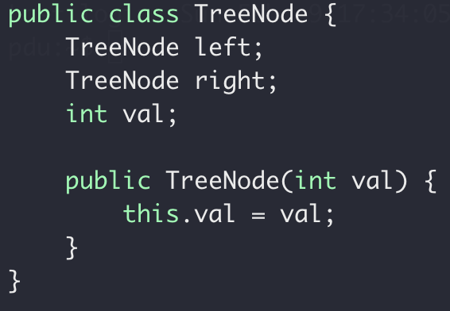
Tree Node
Implementation
Data storage:
Array
List
TreeNode
Left
Right

Slide 45
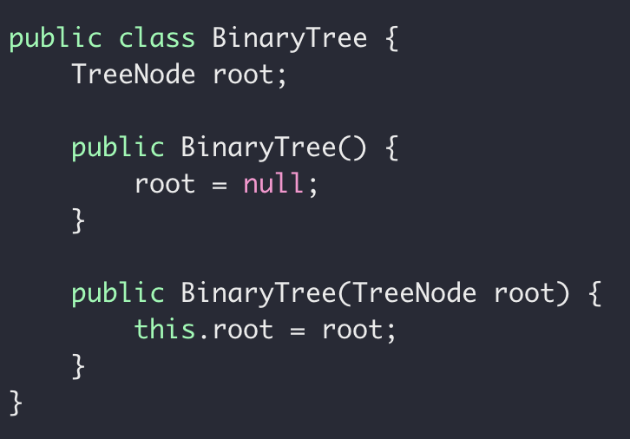
Tree ADT
Implementation
Data storage:
Array
List

Slide 46
Tree Traversal
How many nodes in a tree?
Given a binary tree, how to traverse the node?
Destructor

Slide 47
Binary Tree Traversal
Pre-order: root, left, right
3
1
1
5
2
7
2
7
8
1, 2, 7
3, 1, 2, 7, 5, 8

Slide 48
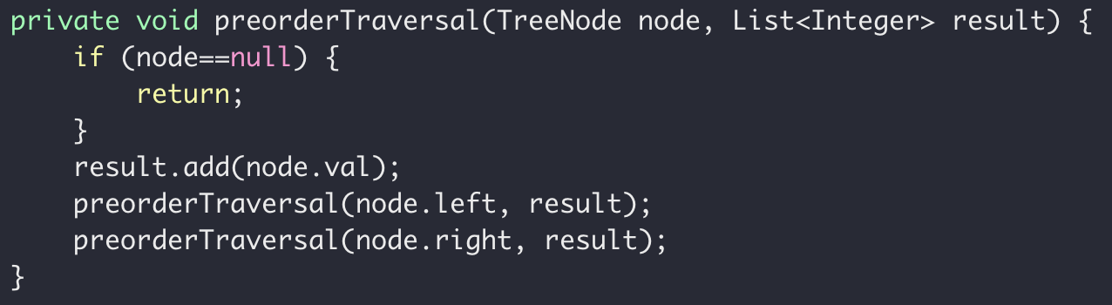
Code it up!
preorder: Root, Left, Right
3
1
5
2
7
8

Slide 49
Exercise
What’s the pre-order traversal of this tree?
8
3
10
9
14
1
6
4
7
Binary Search Tree

Slide 50
Binary Tree Traversal
In-order: left, root, right
3
1
1
5
2
7
2
7
8
2, 1, 7
2, 1, 7, 3, 8, 5

Slide 51
Exercise
What’s the inorder traversal of this tree?
8
3
10
2
14
1
6
4
7
In: 1, 3, 4, 7, 6, 8, 2, 10, 14
In: 1, 3, 4, 6, 7, 8, 2, 10, 14

Slide 52
Binary Tree Traversal
Post-order: left, right, root
3
1
1
5
2
7
2
7
8
2, 7, 1
2, 7, 1, 8, 5, 3

Slide 53
Exercise
What’s the postorder traversal of this tree?
8
3
10
2
14
1
6
4
7

Slide 54
Testing Library

Slide 55
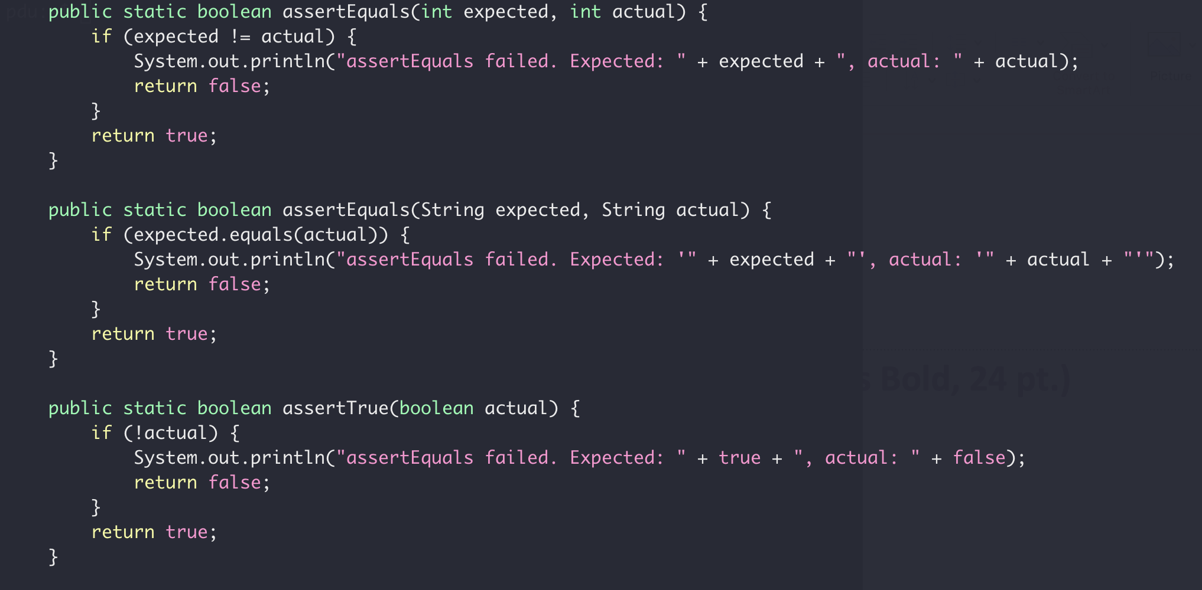
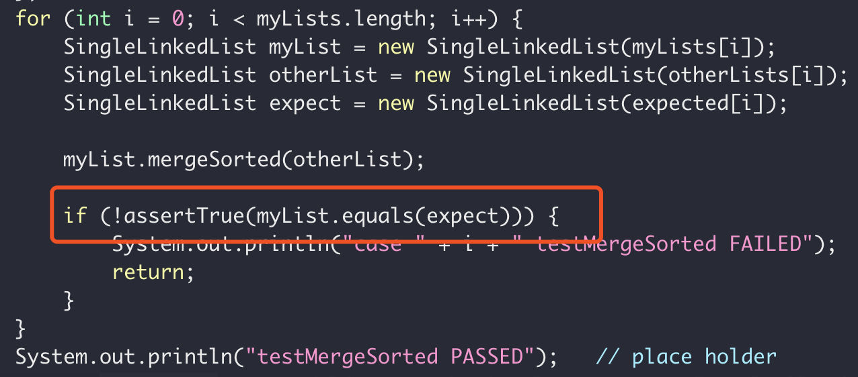
Testing Library
Previously…

Slide 56

Testing Library
Introducing
JUnit is a simple framework to write repeatable tests.
https://junit.org/junit4/

Slide 57
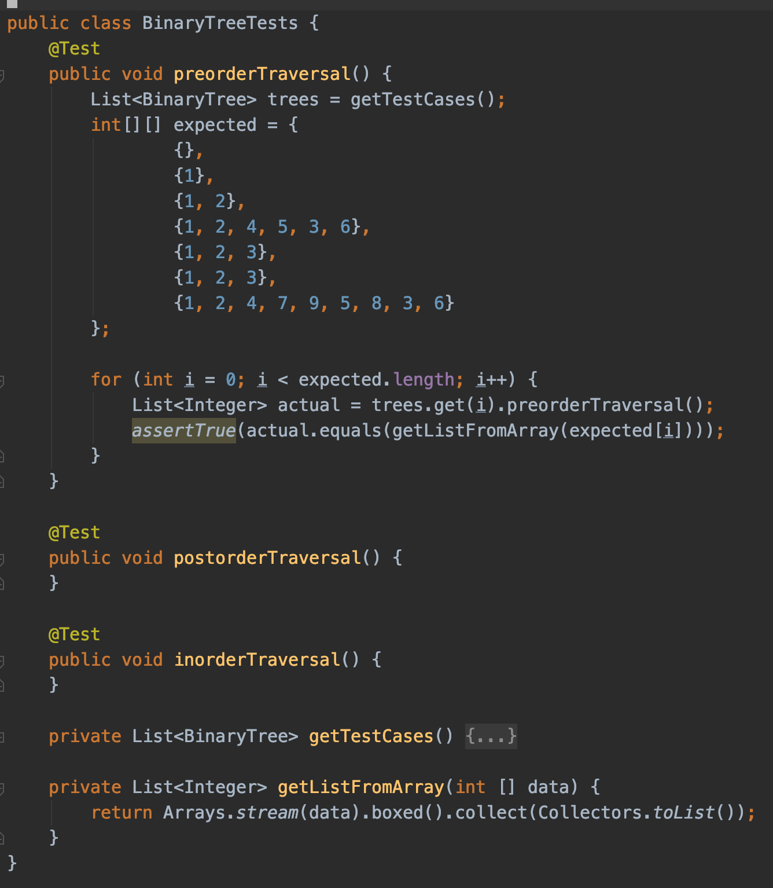
Testing Library

Slide 58
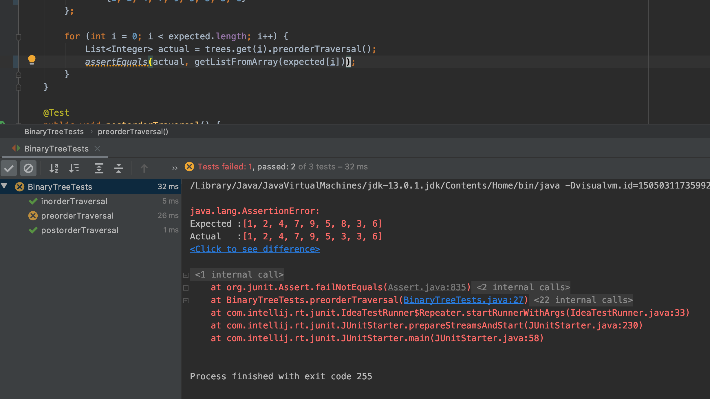
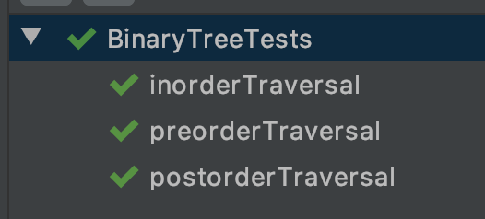
Testing Library

